Slide 1
Corona Trend (EDA + Prediction) MVP
Using deep-learning methods (LSTM)

Slide 2


Summary
Details

Slide 3



Executive Summary
To better understand disease progression, we’ve developed a robust (and extensible) MVP forecasting engine using Deep Learning Method (LSTM) …
… with the following insights.
 | Objective | Build forecasts for COVID19 disease progression using Deep Learning Method (LSTM)
 | Complication | 3253 trends in 58 states (one trend per town) 77 days of data (2020/01/22 – 2020/04/07) Uni-variate (temporal) data for forecasting
 | Approach
Accuracy using LSTM on trend for Middlesex county using 7 hold-out days = 86%
The lower accuracies are in the recent days, where the trend seems to be getting better
Current Deliverable
Next Phase
Accuracy = 1 – abs(RMSE / Actual Volume)
RMSE = Root Mean Square Error, a measure of how good the forecasts are in out-of-time hold-out days (1 week)
Understand
data
Build MVP
using 1 algorithm
Enhance
Forecasting Process
Create Modeling Dataset
Distributions
Temporal trends
Build Dash framework to visualize data
LSTM on 1 trend
Data enrichment (exogenous data)
Algorithm enrichment

Slide 4
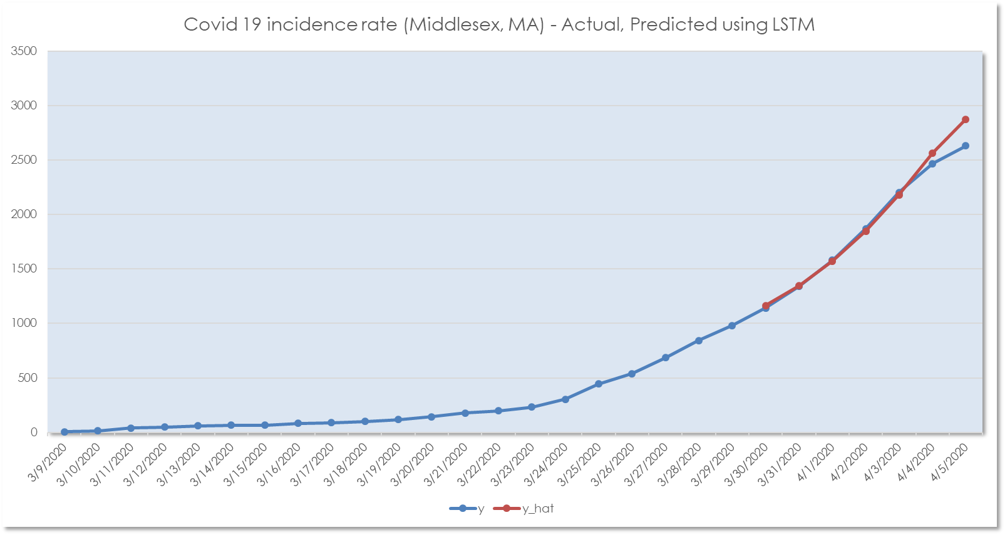
Actual trend vs. predicted using LSTM
The difference between actual vs. predicted incidence (where actual incidence is lower) is a good thing.

Slide 5
Summary
Details

Slide 6

Understand Data

Slide 7
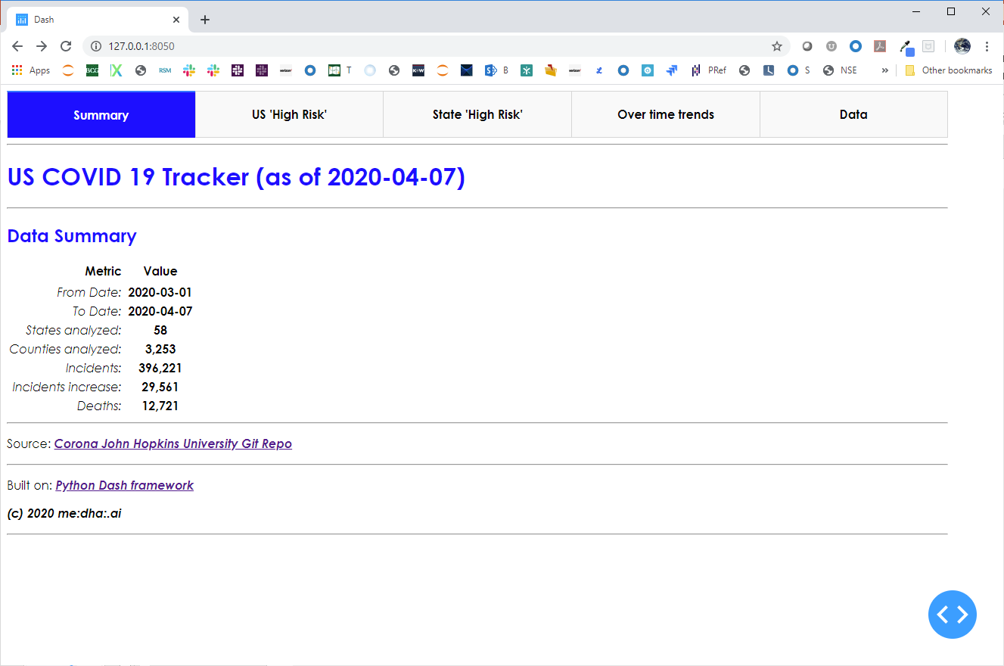
Dashboard layout
When this dashboard is launched from the command line, one can view the results in a web-browser
The 1st tab is a summary snapshot of the latest trends
The 2nd tab has an US-level view of high-risk states/counties
The 3rd tab has a State-County level view
Over-time trends allow one to compare trends across towns
The data tab allows one to parse through the data
1
2
3
4
5
6

Slide 8
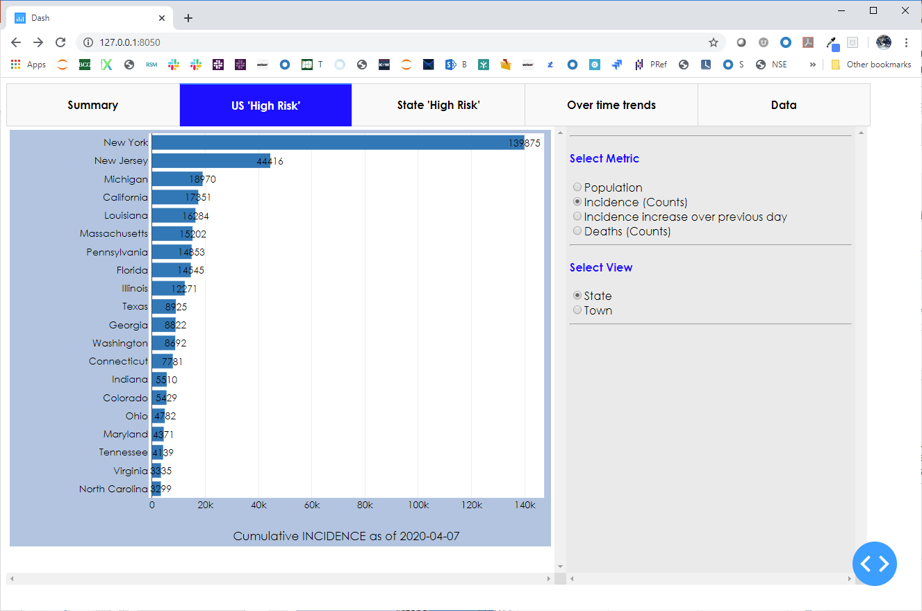
US View –incidence counts on latest day
US-level view (only looking at the high risk states / towns)
The user has the ability to change the metric and view to get to the latest trends
1
2
3

Slide 9
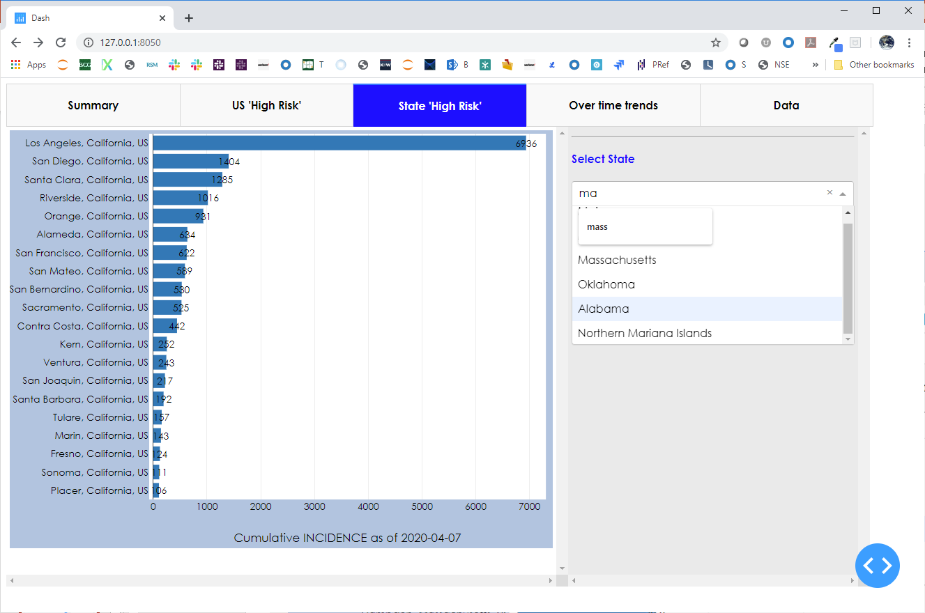
State View (grain = town)
State high risk town tab
Contextual filtering
Towns rank ordered by metric
The metric value
1
2
3
4

Slide 10
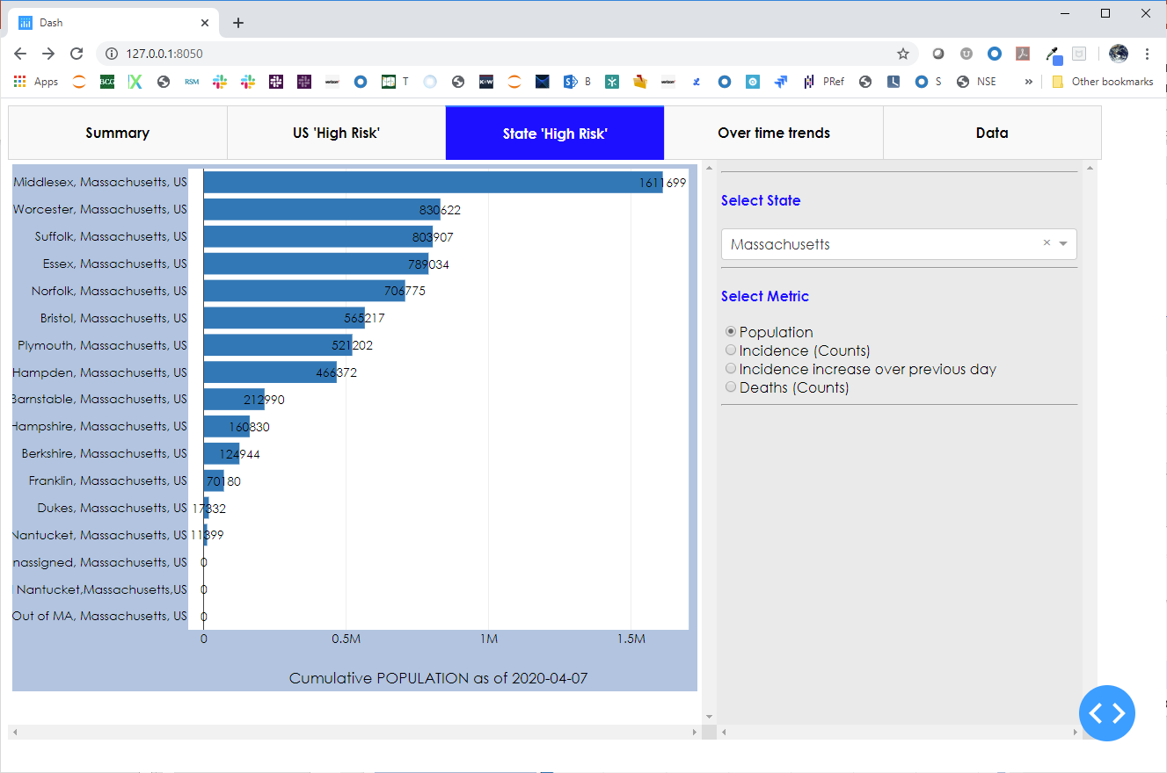
State View (grain = town) – population
Middlesex and Worcester counties are the most populated.
The population in Essex and in Suffox counties are much smaller
1
2
3
4

Slide 11
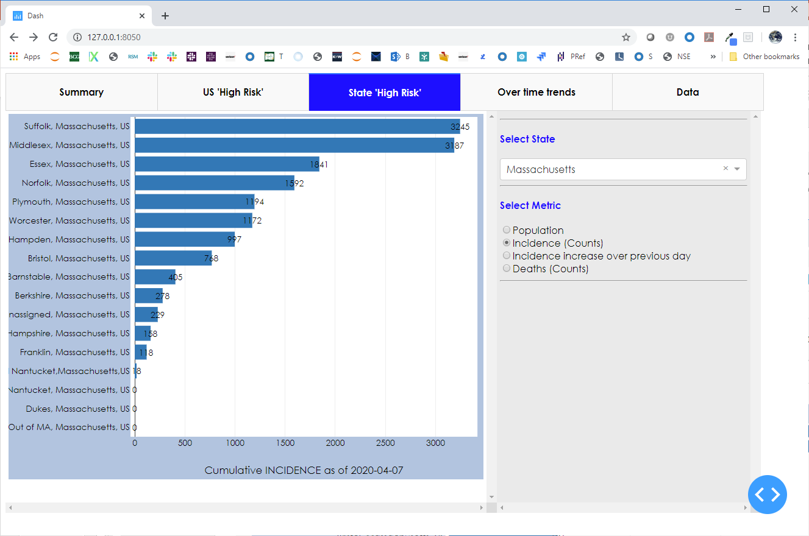
State View – cumulative incidence till 04/07/2020
Although Middlesex is the the largest county by population, Suffolk county has more cases likely due to population density
1

Slide 12
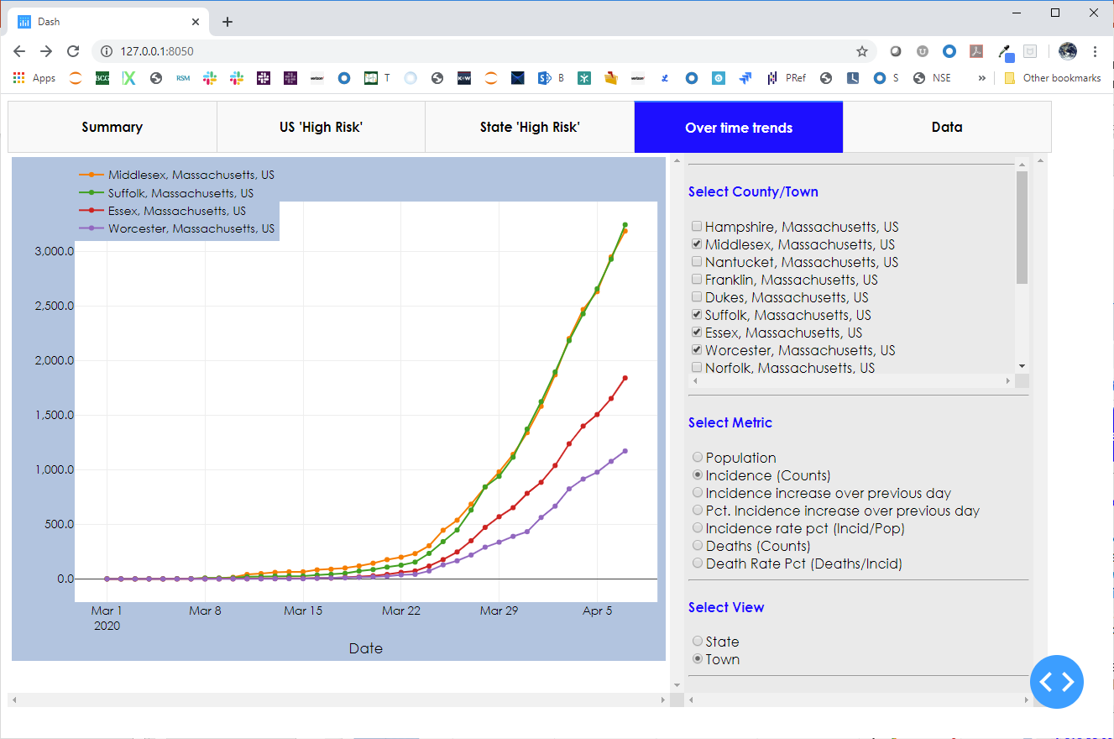
Town trend – incidence trend over time
The user can drill into and add / remove towns to understand trends
7 different trends and 2 views (at the state-level or at an individual-town level) help one to understand different growth disease spread patterns
The chart on the left auto-refreshes based on selections
1
3
2

Slide 13
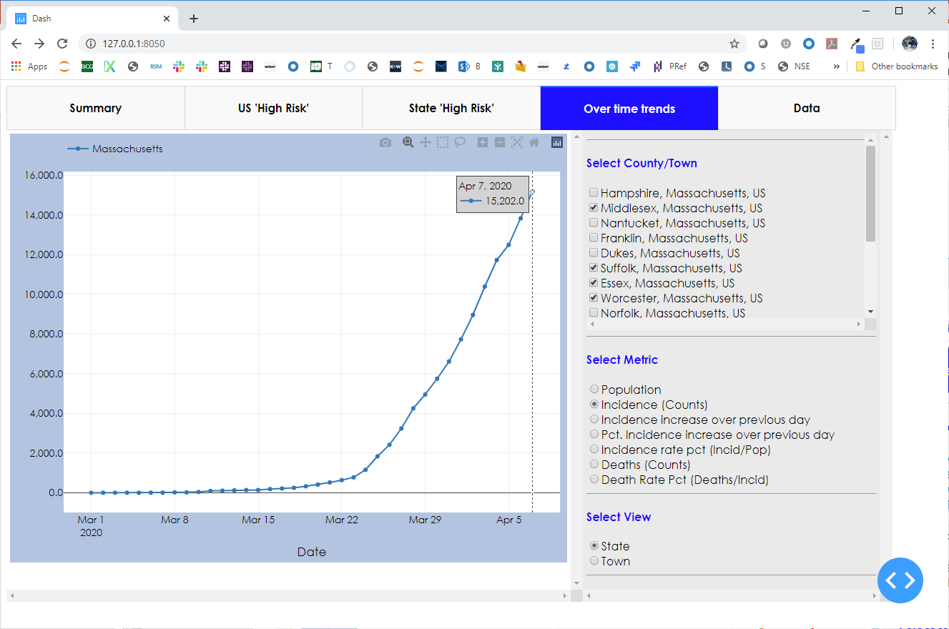
Town trend – incidence trend over time
Toggling to the state view, one can see the state-level information
2
1

Slide 14
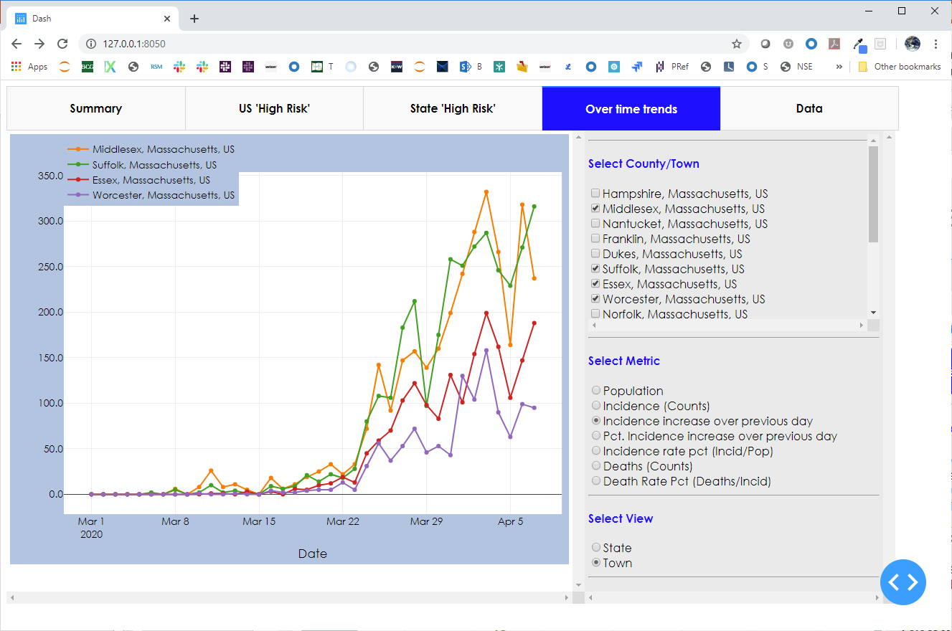
Town trend – incidence increase over time
Incidence counts seem to be a function of size of the counties
1
2

Slide 15
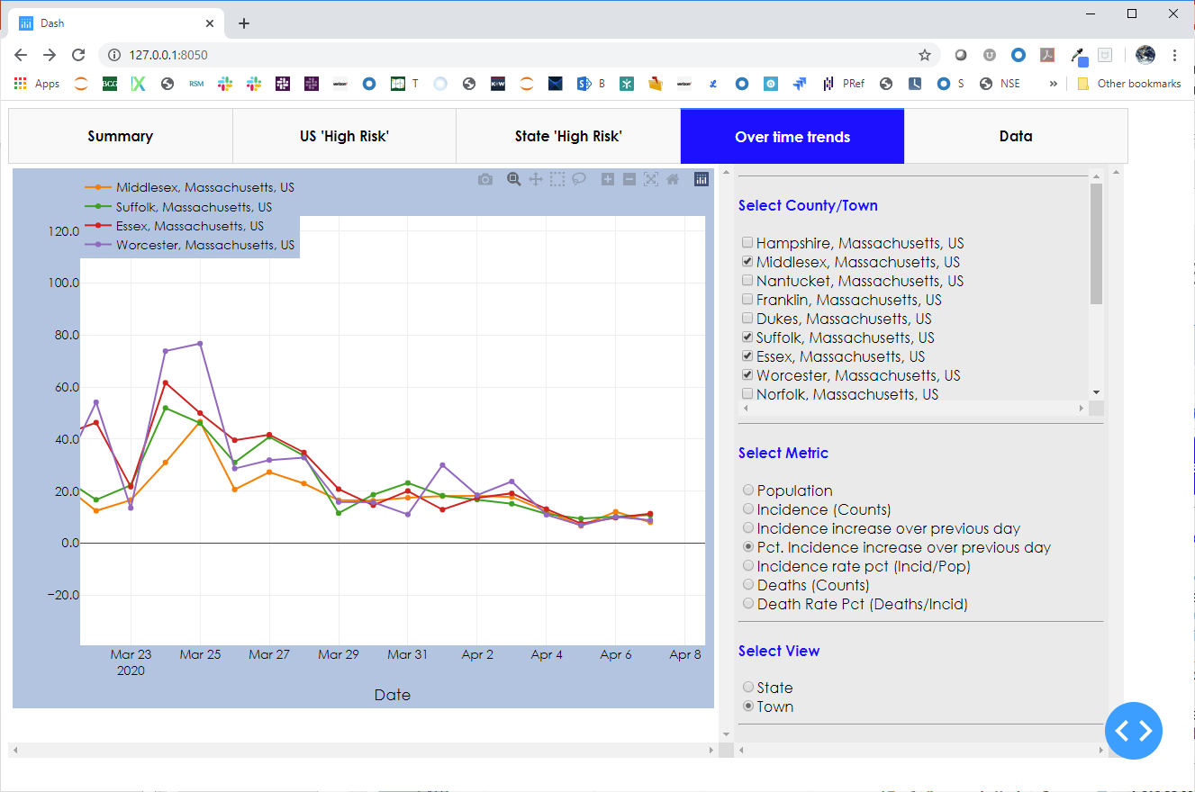
Town trend – incidence increase over time
Incidence counts seem to be a function of size of the counties as most day over day growth rates are almost similar
The day over day growth seem to be more or less steady. So, social distancing seems to be indeed helping and will need to continue.
1
2

Slide 16
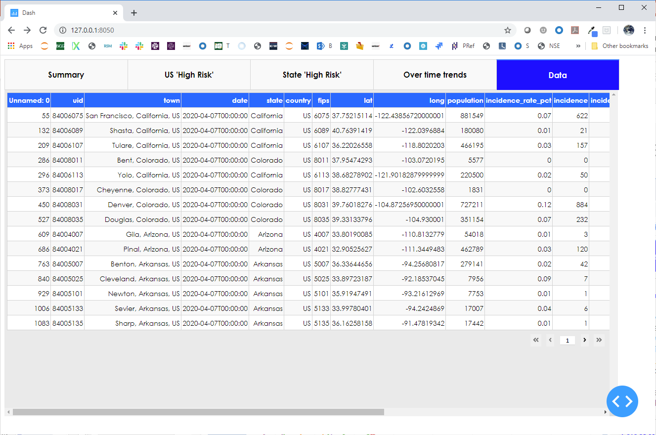
Data in a data-table
A data table construct helps navigate the data a bit more easily
1
2

Slide 17

Build MVP

Slide 18

Algorithm development steps
Generating forecasts @ scale involves getting through 18 steps including …
Prepare
data
Build MVP
using 1 algorithms
Save
Results
Start
Git Clone
Build
Configuration File
Build Prophet Forecast Module
Build Outlier handling Module
Build Saving of Results to DB
Load
Data into DB
Build Utility Libraries
(IO, Data)
Build Holt-Winter Forecast Module
Build Result Visualization Module
Build Saving of Results to Excel
Merge datasets & prepare Modeling Data Set
Parametrize forecast generation
Build LSTM
Build Result Ensemble Module
End
Build Visualizations & Explore Data in Dash
Build wrapper code
Build Canonical Model to Consume Results
Build Metrics Reporting Module
Sprint #1
Sprint 1+

Slide 19

Enhance Forecasting Process

Slide 20

Enriching components – data & algorithms
Data enrichment can occur through the inclusion of data sources such as …
… and algorithm enrichment can occur by evaluating output from algorithms including …
# | Data Type | Example
1 | Population | Size Age distributions Find similar towns around the globe
2 | Others | Lock-down period start Degree of lock-down Exposed individuals and Susceptible Individual movements
# | Algo. Type | Example
1 | Explainable | Naïve (Moving average) Multi-variate regression Decision tree Exponential Smoothing ARIMA ARIMAX
2 | Blackbox (with SHAP) | Multi-variate scenarios (with exogenous variables) Random Forest Adaboost

Slide 21
Appendix – Files in package

Slide 22
Files in the package
# | Component | File(s) | Purpose
1 | Git Clone & Daily Pull | Time_series_covid19_confirmed_us.csv Time_series_covid19_deaths_us.csv | Raw data (https://github.com/CSSEGISandData/COVID-19)
2 | Data Prep | 01_parse_covid_data.ipynb 02_create_modeling_data_set.ipynb 03_build_lstm_model.ipynb | Load data into SQL (for posterity) Prepare data Leverage output from data & model in Dash / Other viz. tools
3 | Data (& Result) Exploration | 04_app.py (Launches a dashboard on the Web) | Understand the various dimensions of data Use dimensions to infer patterns and improve forecasting algorithms
4 | Output | Covid19_2020_04_05.csv Covid_ms_data.xlsx | The modeling dataset for data prepared till 04/05/2020 The output of LSTM
5 | Discussion | 05_corona_trend_mvp_2020_04_05_v2 | This deck to summarize insights for broader discussion

